Slide 1

Non-Public Schools NCTest Training
April 29, 2026

Slide 2
Training Goals
Test Materials & Security Forms
Protocol for Tech Support
Two Factor Authentication
Accessing Class Roster Reports
Steps to Prepare for Testing
TWS and ISRs
Chromebook App (PWA)

Slide 3
Test Materials & Security Agreements
STCs will receive Test Administration Guides and Graph Paper. School ID will be at the top of the order form.
A return label will be in each shipment.
Print out Test Administrator and Proctor Security Agreements from NPSTS webpage as needed and return with materials.
Email Brian if you have a testing irregularity. A form will be required to document it.

Slide 4
Protocol for Tech Support
Go to NPSTS webpage and use provided documentation. Everything you need for administering online tests is there.
01
Call or email the help desk (919-515-1320 or ncdesk@ncsu.edu). Be sure to identify yourself as a
non-public school.
02
Call or email Brian (919-515-4624 or brian_swiger@ncsu.edu)
03

Slide 5
Two Factor Authentication
Required to access NCTest Admin
Instructions under Quick Start Guide section

Slide 6

Steps to Prepare for Testing
Set up Test Coordinator and Test Administrator Accounts in NCAuth
Complete and Upload the Student Upload Spreadsheet
Install the Appropriate NCTest Program/Application on All Testing Devices
Ensure All Testing Devices Meet the Required Technology Specifications
Complete the Required SEB Tutorial for Students and Teachers

Slide 7
Accessing Class Roster Reports
Instructions on the NPSTS web page
Accessing Online Resources for Summative Assessments Guide (PDF)
Accessing Online Resources for Summative Assessments Training Video

Slide 8

Testing Window Scheduler and ISRs
I will set your TWS in NCTest Admin.
I will mail you the Individual Student Reports.

Slide 9
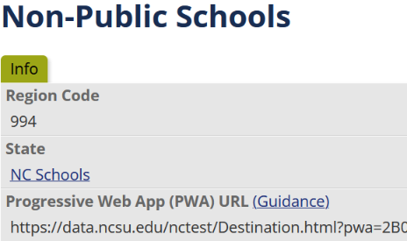
Chromebook App (PWA)
Chromebooks must access NCTest through the Progressive Web App.
It is located in NCTest Admin.
Uninstall old app first.
Installation guide on NPSTS web page.

Slide 10
Thank You!
Thank you for your patience and participation in the NC Non-Public Schools Testing program!

