Slide 1
Non-Public Schools NCTest Training
April 29, 2025

Slide 2
Training Goals
New Tasks for 2025
Test Materials & Security Forms
Protocol for Tech Support
Two Factor Authentication
Quick Start Guide
Other Resources
Report Training
My Schedule

Slide 3
New Tasks for 2025
Two Factor Authentication for NCTest Admin
School Test Coordinators (STC) will approve Test Administrator accounts.
STCs will upload Student Enrollment spreadsheets.
STCs will use new reporting tool to access student reports.

Slide 4
Test Materials & Security Agreements
STCs will receive Test Administration Guides and Graph Paper. School ID will be at the top of the order form.
A return label will be in each shipment.
Print out Test Administrator and Proctor Security Agreements from NPSTS webpage as needed and return with materials.
Ask for Accommodations Form if necessary.
Email Brian if you have a testing irregularity. A form will be required to document it.

Slide 5
Protocol for Tech Support
Go to NPSTS webpage and use provided documentation.
Call or email the help desk (919-515-1320 or ncdesk@ncsu.edu). Be sure to identify yourself as a non-public school.
Call or email Brian (919-515-4624 or brian_swiger@ncsu.edu)

Slide 6
Two Factor Authentication
New this year
Required to access NCTest Admin
Instructions under Quick Start Guide section

Slide 7
Quick Start Guide
Located on NPSTS webpage
Contains 2FA instructions
Abbreviated NCTEST Admin guide
4 Steps to Testing (I will schedule your tests once your students are enrolled.)
Take it one step at a time
Start tomorrow ☺

Slide 8
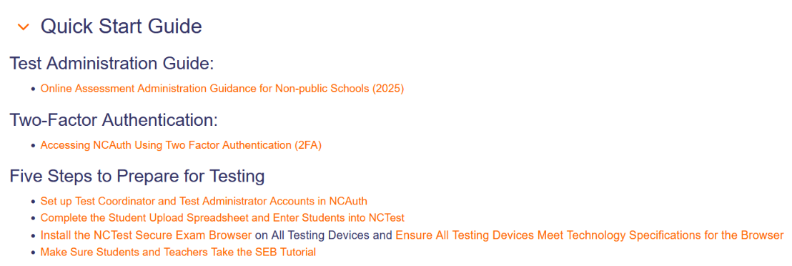
Quick Start Guide

Slide 9
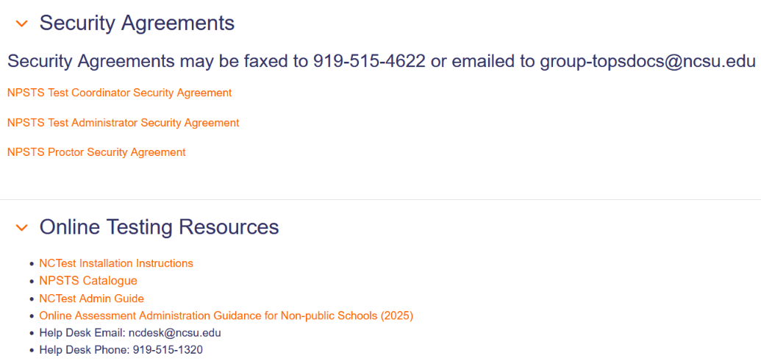
Other Resources

Slide 10
Report Training
May 14th at 10 AM
Online tool will enable School Test Coordinators to run and print student reports within 24 hours.
Training will be recorded and posted on NPSTS website.
I will be learning with you!

Slide 11
My Schedule
I will be out of the office from May 8 – May 13.
I will be in the office the rest of testing season from 9-5 M-F.

Slide 12
Thank You!
Thank you for your patience and participation in the NC Non-Public Schools Testing program!

